Slide 1
The Movie Data Base(TMDB)— Benford Analysis
Xiangliang Liu
12/16/2018

Slide 2
Outline
Data exploration
Data visualization
Benford analysis:
Conclusion:

Slide 3
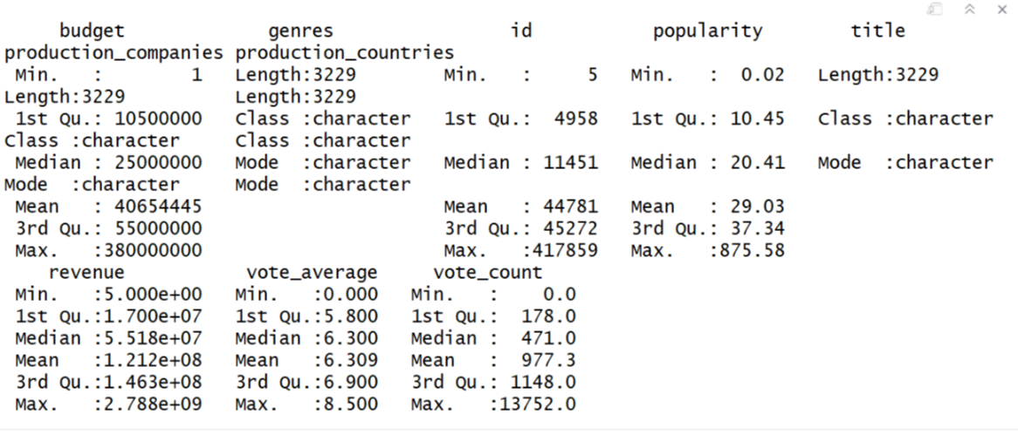
OVERVIEW ABOUT THE movie data base:

Slide 4

EDA(1):Word cloud with different genres:
The size of word represent the number of movies in that catagory
Drama, Comedy and Action are the genres with most number of movies.

Slide 5
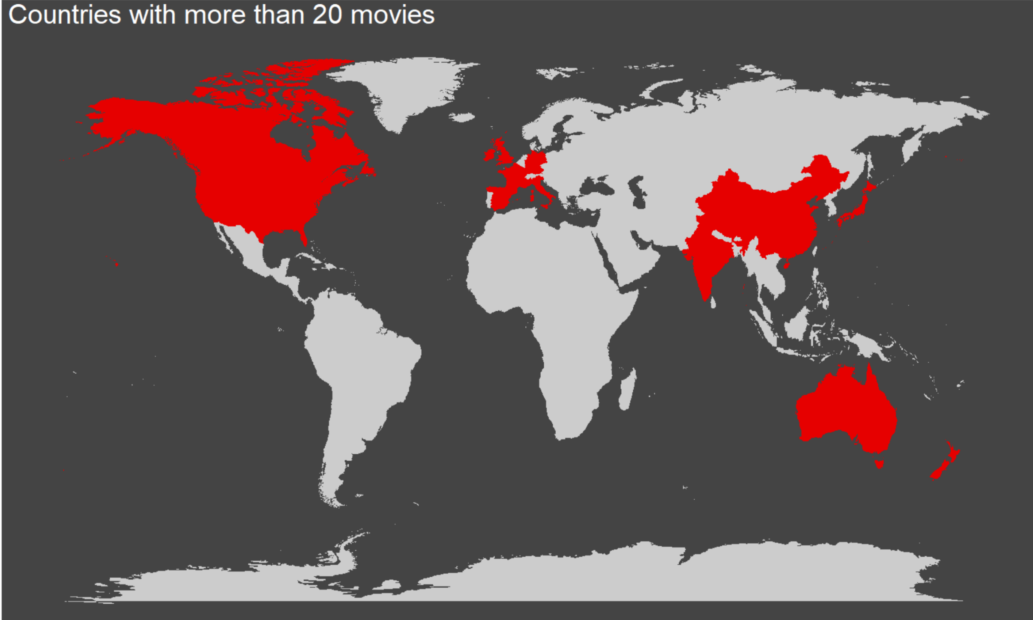
EDA(2) Map about the countries produced most movies:

Slide 6
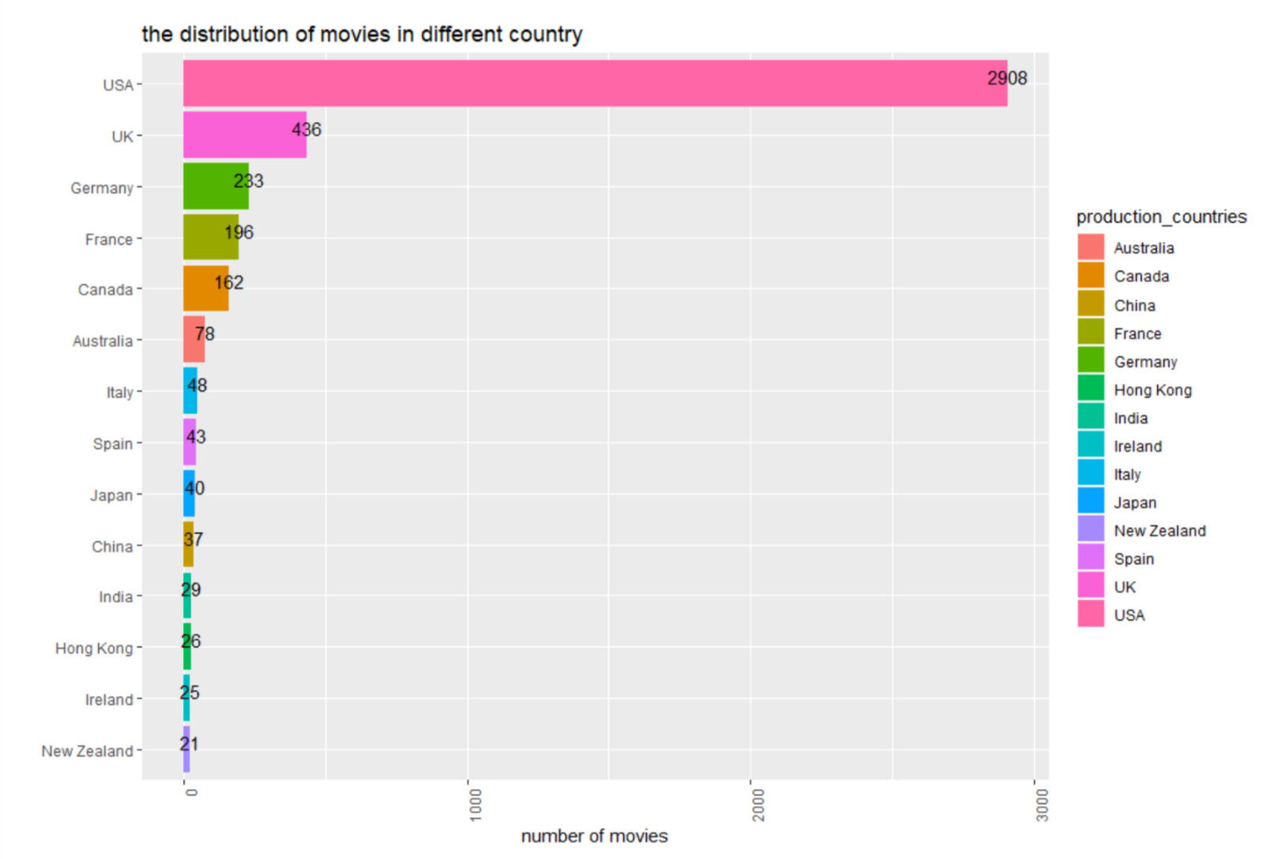
EDA(3) distribution of countries
It turns out that USA has the largest proportion of movie in the dataset .
The proportion of movies from USA is nearly 60%

Slide 7
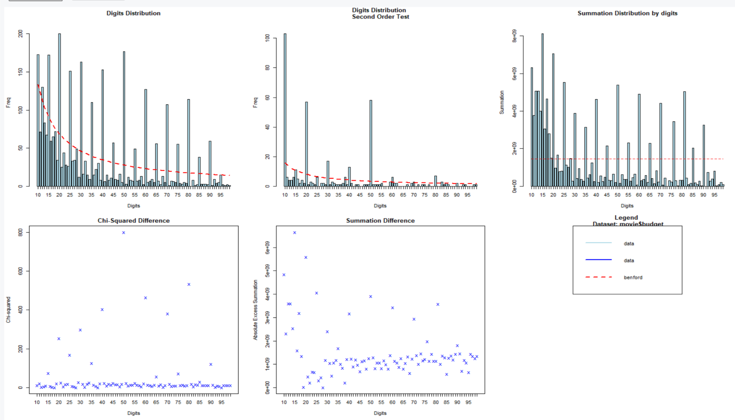
Benford analysis on variable budget:
A lot of lines exceed the red line threshold. The distribution of budget may not follow benford distribution.

Slide 8
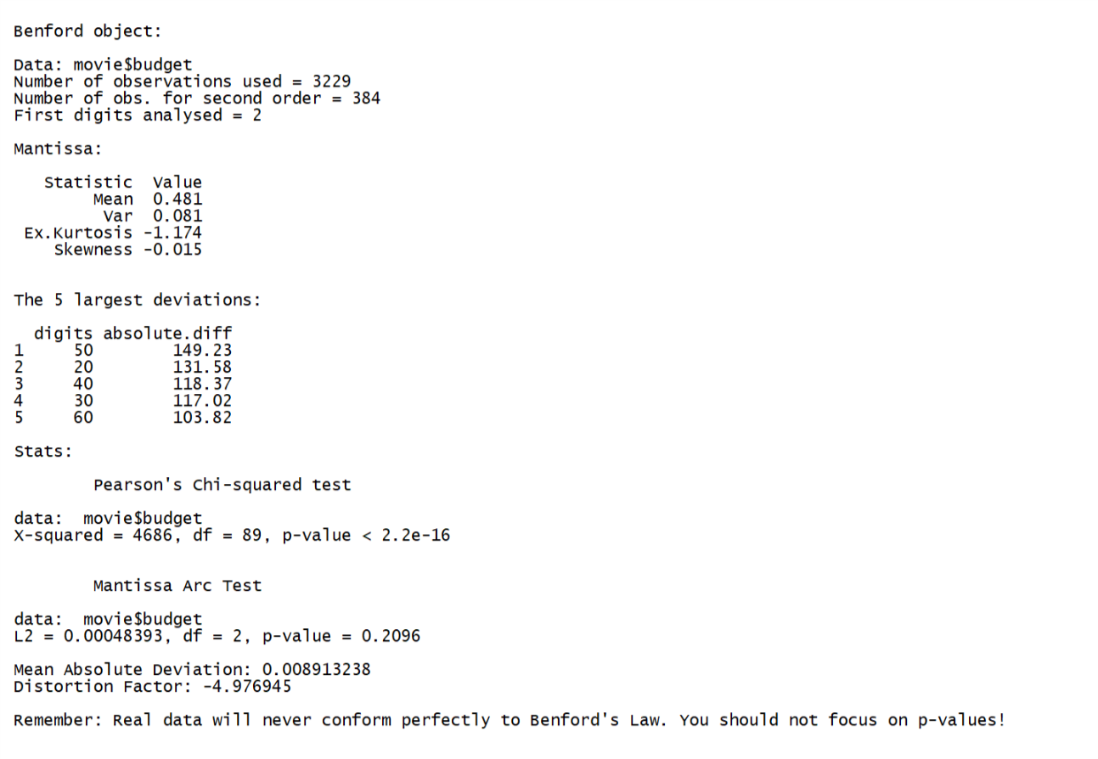
Benford summary on budget:

Slide 9
Conclusion:
We found the budget numbers do not significantly follow Benford analysis. The budget that start with 50 and 20 have the highest deviation.
This result does make sense, because when people decide to make a movie or approve a movie, they never specific the budget to a unit digit. For instant, the number could be 500 million or 200 million dollars

Slide 10
Thank you

